Slide 1
Effects of antiplatelet therapy after stroke due to intracerebral haemorrhage (ICH): extended follow-up of the REstart or STop Antithrombotics Randomised Trial (RESTART)
RESTART Collaboration
www.RESTARTtrial.org

Slide 2
Intracerebral haemorrhage (ICH) is associated with an increased risk of arterial ischaemic events*: pooled analysis of 4 population-based cohorts
Ischaemic stroke
Myocardial infarction
* adjusted for age, sex, race/ethnicity, vascular comorbidities, and antithrombotic medications
JAMA Neurol 2021;78:809-16

Slide 3
Major vascular events are common after any ICH: pooled analysis of 2 population-based UK cohorts
ICH sub-group (by presence of atrial fibrillation [AF] or occlusive vascular disease) | Estimated annual rate of outcomes, % per year (95% CI)
 | Recurrent ICH | Ischaemic stroke | Any major vascular event
No AF or occlusive vascular disease | 2.9 (1.3-6.7) | 0.8 (0.1-5.5) | 5.9 (2.7-12.9)
Lone AF | 3.6 (1.3-10.3) | 7.2 (3.4-15.1) | 11.3 (6.3-20.4)
Co-morbid occlusive vascular disease, no AF | 3.9 (1.4-10.6) | 1.1 (0.3-3.8) | 10.3 (6.9-15.3)
Co-morbid occlusive vascular disease and AF | 4.1 (1.4-12.4) | 5.7 (2.5-12.6) | 19.4 (9.0-41.7)
Lancet Neurology 2021;20:437-47

Slide 4
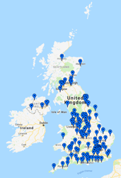
537 adults ≥18y, taking antithrombotic (antiplatelet or anticoagulant) therapy for the prevention of occlusive vascular disease at ICH onset, who discontinued antithrombotic therapy, and survived ≥24h
Brain MRI before randomisation
122 hospitals in the UK
Randomisation (central)
1:1
268 START antiplatelet therapy*
269 AVOID antiplatelet therapy
Follow-up (central, masked) for vascular events, death, mRS, adherence, BP control
* Aspirin or clopidogrel or dipyridamole (open, no placebo) ISRCTN71907627

Slide 5
Antiplatelet therapy seemed safe and possibly beneficial in RESTART
Start vs. avoid antiplatelet therapy
Adjusted HR 0·51 (0·25–1·03): p=0·060
Start vs. avoid antiplatelet therapy
Adjusted HR 0·65 (0·44–0·95): p=0·025
Avoid: n=65/268 (24·3%)
Avoid: n=23/268 (8·6%)
Start: n=45/268 (16·8%)
Start: n=12/268 (4·5%)
Follow-up time (y): median 2·0y, 99·3% complete
Follow-up time (y): median 2·0y, 99·3% complete
Lancet 2019;393:2613-23 & Lancet Neurol 2019;18:643-52

Slide 6
ICH guidelines since RESTART
In patients with an indication for continued antiplatelet treatment, resuming antiplatelet therapy is reasonable
(Evidence Level B)
If necessary, patients with ICH may consider antiplatelet monotherapy
(Class IIa, Level of Evidence B)
Int J Stroke 2021;16:321-41 and Stroke & Vascular Neurology 2020;5:e000433

Slide 7
Extended follow-up of RESTART
537 participants recruited 22 May 2013 to 31 May 2018
Main follow-up ended 30 November 2018
median 2·0y, total 1,064 person-years, completeness 99·3%
Extended follow-up to 30 November 2020
median 3·4y, total 1,805 person-years, completeness 97·9%
Median systolic BP ~130mmHg throughout
Very few switched to oral anticoagulation
Extended follow-up results

Slide 8
Adherence to allocated strategy before the first outcome after randomisation
 | Main results |  | Extended follow-up
 | Start antiplatelet therapy (n=268) | Avoid antiplatelet therapy (n=269) | Start antiplatelet therapy (n=268) | Avoid antiplatelet therapy (n=269)
Discharge | 259/265 (98%) | 264/266 (99%) | 259/265 (98%) | 264/266 (99%)
Year 1 | 193/218 (89%) | 205/211 (97%) | 194/216 (89%) | 204/210 (97%)
Year 2 | 104/122 (85%) | 105/113 (93%) | 158/181 (87%) | 154/169 (91%)
Year 3 | 59/71 (83%) | 61/69 (88%) | 108/129 (84%) | 110/126 (87%)
Year 4 | 21/26 (81%) | 20/24 (83%) | 64/81 (79%) | 61/77 (79%)
Year 5 | 2/0 (100%) | 3/4 (75%) | 33/40 (83%) | 44/51 (86%)
Year 6 | - | - | 7/12 (58%) | 12/17 (71%)
Year 7 | - | - | 1/1 (50%) | 3/0 (100%)
Extended follow-up results

Slide 9
Recurrent ICH (primary) overall
Start vs. avoid antiplatelet therapy
Adjusted HR 0·87 (0·49–1·55): p=0·639
Avoid: n=25/268 (9·3%)
Start: n=22/268 (8·2%)
Follow-up time (y): median 3·4y, 97·7% complete
Extended follow-up results

Slide 10
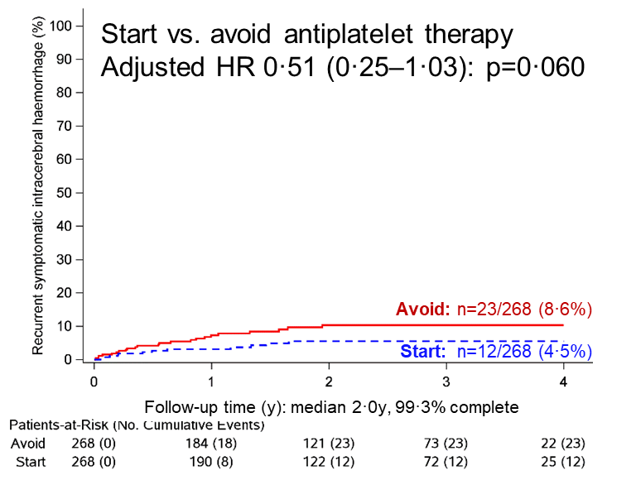
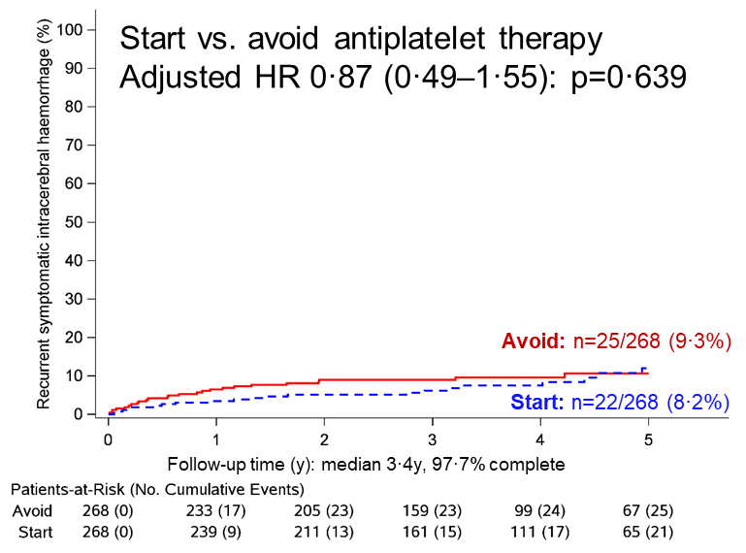
Recurrent ICH (primary) overall
Main results
Extended follow-up
Main results vs. extended follow-up results

Slide 11
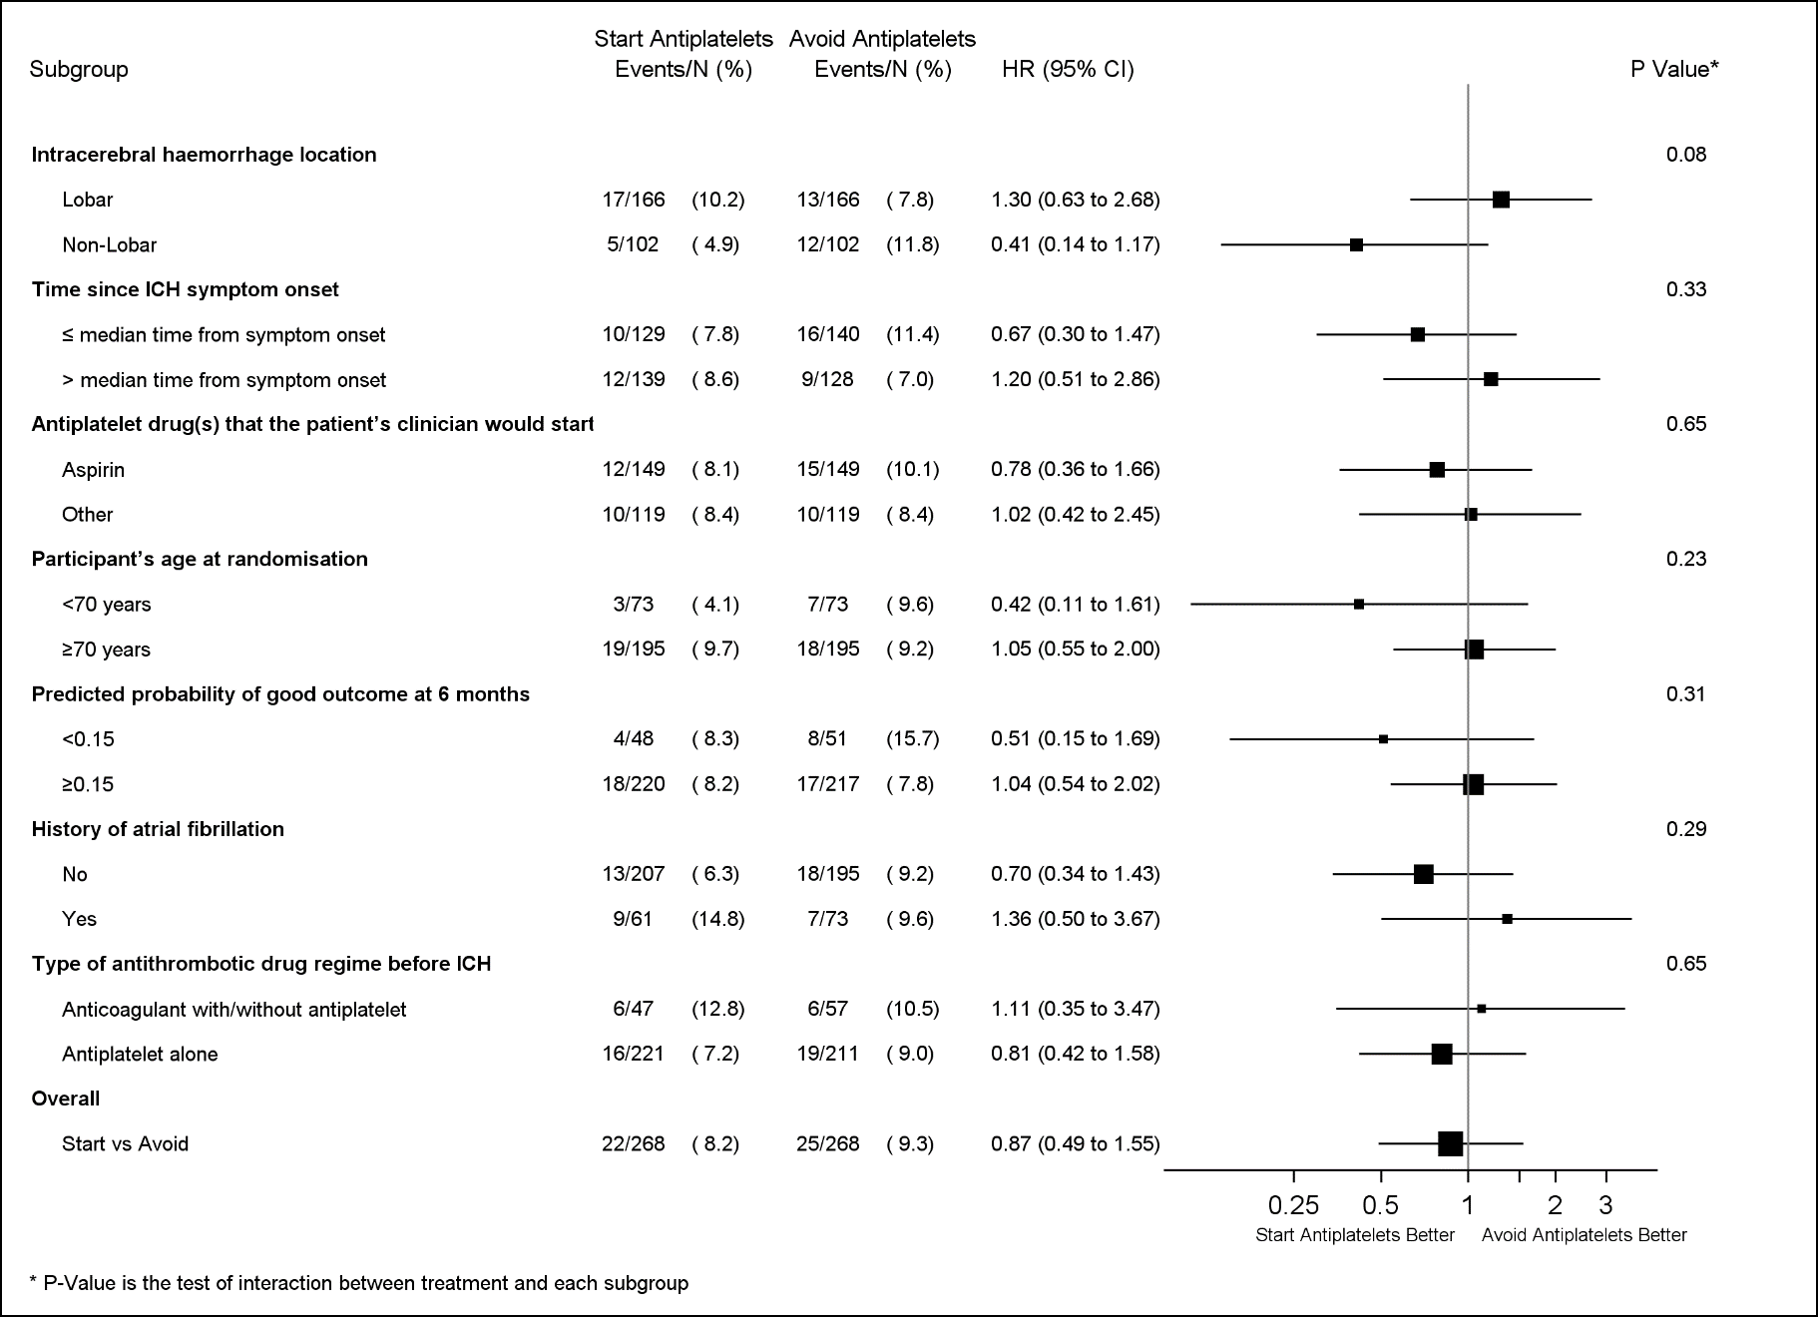
Recurrent ICH (primary) sub-groups
Extended follow-up results

Slide 12
Secondary outcomes
 | Start antiplatelet therapy (n=268) | Avoid antiplatelet therapy (n=269)
Primary
Recurrent symptomatic intracerebral haemorrhage | 22 (8%) | 25 (9%)
Secondary (selected outcomes shown)
Other intracranial haemorrhage | 6 (2%) | 4 (2%)
Major extracranial haemorrhage | 6 (2%) | 2 (1%)
Ischaemic stroke | 28 (10%) | 39 (15%)
Myocardial infarction | 11 (4%) | 10 (4%)
Extended follow-up results

Slide 13
Secondary composite outcomes
 | Start antiplatelet therapy (n=268) | Avoid antiplatelet therapy (n=268) | Adjusted HR (95%CI) | p value
All major haemorrhagic events | 32 | 30 | 1·07 (0·65–1·76) | 0·793
All major occlusive vascular events | 57 | 53 | 1·09 (0·75–1·59) | 0·642
All major haemorrhagic or vaso-occlusive events | 84 | 78 | 1·08 (0·79–1·47) | 0·620
Serious vascular events (specified in protocol)* | 72 | 87 | 0·79 (0·58–1·08) | 0·141
* defined by the Antithrombotic Trialists’ Collaboration (ATT)
Extended follow-up results

Slide 14
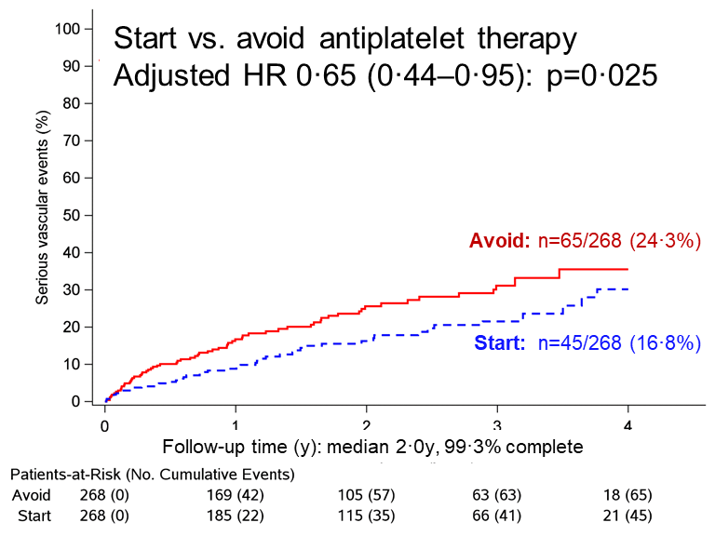
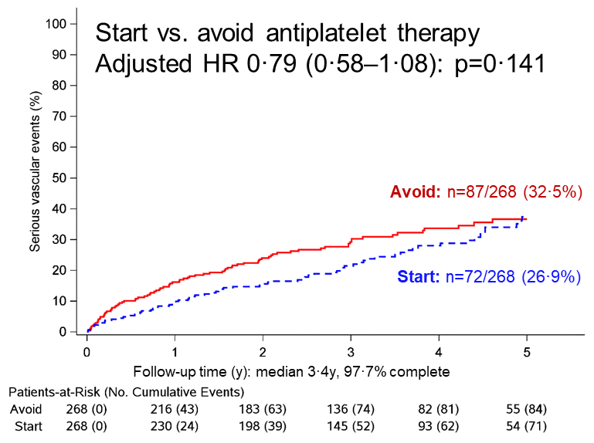
Secondary outcome: ATT-defined serious vascular events
Main results
Extended follow-up
Main results vs. extended follow-up results

Slide 15
Conclusions
Promising directions of effect, but no significant effects of antiplatelet therapy
on the risk of recurrent ICH with antiplatelet therapy (HR 0·87, 95%CI 0·49–1·55; p=0·639)
on the risk of all serious vascular events (HR 0·79, 95%CI 0·58–1·08; p=0·141)
Consistent with effects shown by the Antithrombotic Trialists Collaboration
RESTART was a small, pilot phase trial in the United Kingdom
Ongoing RCTs (RESTART-Fr & STATICH) are smaller than RESTART
Collaborative IPDMA planned,* but unlikely to be definitive
A definitive trial of ~4,000 patients is needed (ASPIRING NCT04522102) to address overall effects, sub-groups, timecourse
* www.crd.york.ac.uk/prospero/display_record.php?ID=CRD42021246133

Slide 16
Thank you to everyone who helped…
Participants, relatives, and carers
Collaborators: at 122 hospitals in the UK
Writing group: R Al-Shahi Salman (chief investigator), MS Dennis, PAG Sandercock, CLM Sudlow, JM Wardlaw, WN Whiteley, GD Murray, J Stephen, A Rodriguez, S Lewis, DJ Werring, and PM White
Trial management group: K Innes (senior trial manager); L Dinsmore (imaging manager); J Drever (data manager); C Williams (centre coordinator); D Perry, C McGill, D Buchanan, A Walker, A Hutchison, C Matthews (database programmers); R Fraser, A McGrath, A Deary, R Anderson, A Maxwell, P Walker, K Covil, K Stewart (trial support officers); J Stephen, C Holm Hansen, R Parker, A Rodriguez, R Lee, S Lewis (unmasked independent statisticians)
Trial steering committee: Independent members: C Baigent (chair), J Carrie (patient–public representative), D Lasserson, F Sullivan. Others: R Al-Shahi Salman, MS Dennis, GD Murray, DE Newby, PAG Sandercock, CLM Sudlow, WN Whiteley, N Sprigg, DJ Werring, PM White
Data monitoring committee: J Bamford (chair), J Armitage, J Emberson, GJE Rinkel, G Lowe
Outcome event adjudicators: WN Whiteley, MR Macleod & TJ Moullaali (internal); T Gattringer (external)
Systematic Management, Archiving and Reviewing of Trial Images Service (SMARTIS): JM Wardlaw (director), J Palmer, E Sakka, J Adil-Smith
Brain imaging assessors: PM White, DP Minks, D Mitra, P Bhatnagar, JC du Plessis, Y Joshi
Funder: British Heart Foundation (S Amoils)
Sponsor: ACCORD (J Rojas)
Clinical research networks: NIHR clinical research network, NRS Scottish Stroke Research Network, SINAPSE collaboration
Clinical trials unit: Edinburgh Clinical Trials Unit
TICH-2 trial team: co-enrolment
www.RESTARTtrial.org

