Slide 1
The third international stroke trial (IST-3) effect of thrombolysis on outcomes at 18 months in 2348 patients in long-term follow-up cohort
The IST3 collaborative group - 156 hospitals in UK, Poland, Italy, Sweden, Norway, Australia, Portugal, Belgium, Austria, Switzerland, Canada, Mexico
Disclosures: Boehringer Ingelheim donated rt-PA and placebo for the first 300 patients but had no other part in the study.
Full details – Lancet 2012
29th May 2013
ESC London
Notes:
1

Slide 2
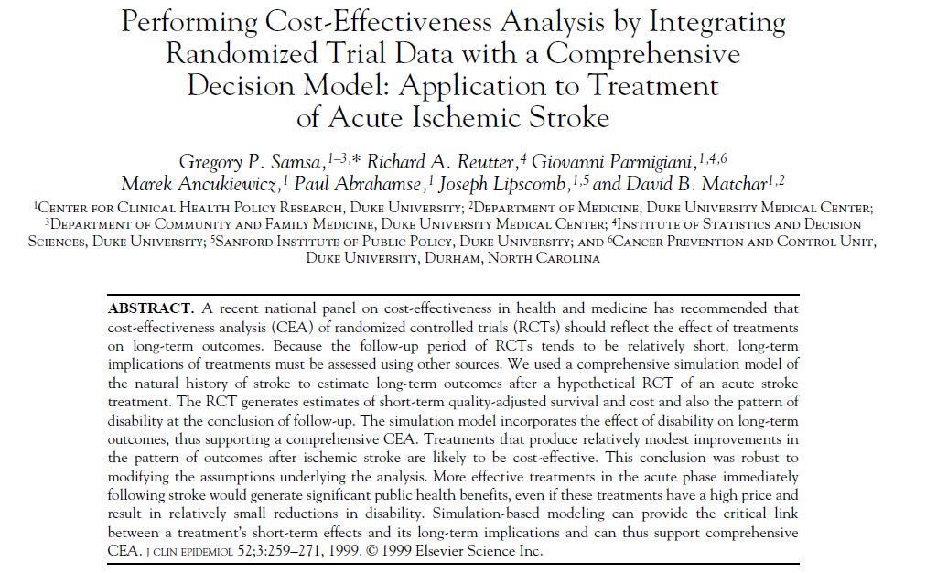
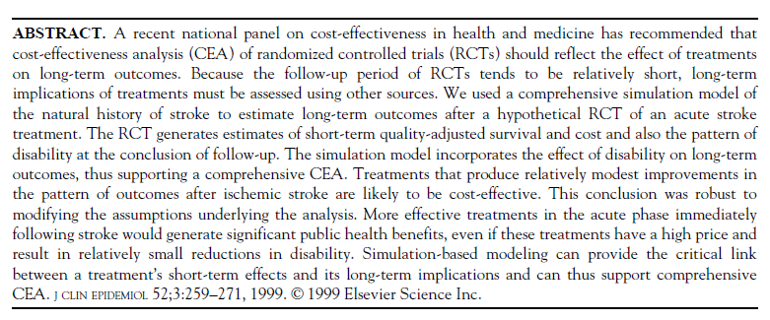

Slide 3
Background
Most data from previous randomised trials based on short follow-up
10 trials (n=3343) follow-up at < 90 days
NINDS (n = 624) at 3, 6 & 12 months
No Quality of Life (QoL) data:
ECASS-2 collected SF-36, but has not reported results
Notes:
3

Slide 4
IST-3
Randomised controlled trial i.v. rt-PA vs. control (n= 3035)
Primary outcome: % ‘alive and independent’ Oxford Handicap Scale (OHS) 0-2
Follow-up at 7 days, 6 & 18 months

Slide 5
Aims and method
Aim: at 18 months, assess survival, OHS, Quality of Life (EQ5D-3L, EQ index and VAS) & living circumstances
Eligibility: patients recruited in the 10 countries participating in 18-mo. FU study.
Method: postal questionnaire completed by patient or proxy or blinded telephone interview by national coordinating centre

Slide 6
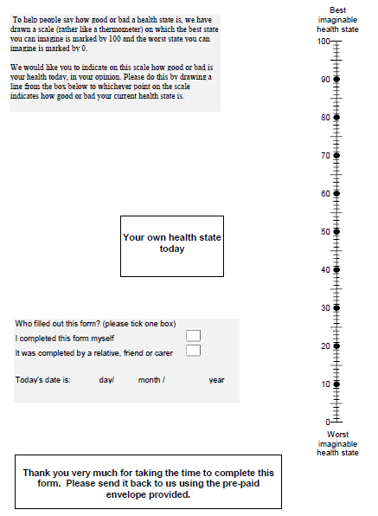
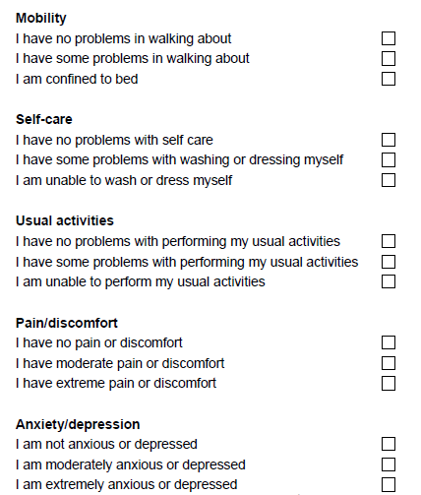
EQ5D – 3L EQ VAS

Slide 7
18-month follow-up cohort
Inclusion and baseline features
2348 eligible for inclusion in 18-month study
Baseline characteristics similar to whole trial
Treatment groups well balanced
At 18 months, health related quality of life
44% completed by patient, 56% by a proxy
EQ 5D utility index could be calculated from responses to EQ5D for 91% of survivors
EQ VAS available for 90% of survivors

Slide 8
Independent (OHS 0-2) at 18 months
rt-PA (n=1169) |  | control (n=1179)
n | (%) | n | (%)
391 | (35%) | 352 | (31%)
Adjusted odds ratio 1.28 (95% CI 1.03-1.35), p = 0.024
= 36 more independent/1000

Slide 9
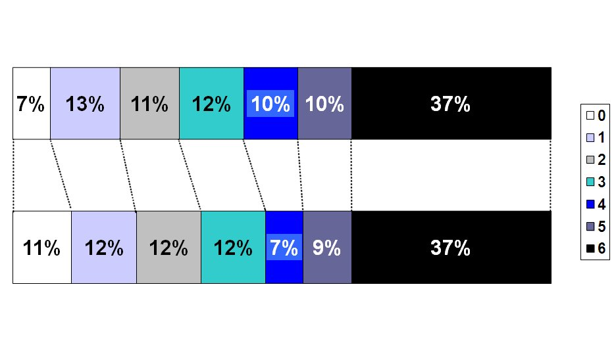
OHS at 18 months
Control
rt-PA
No effect on death
Favourable shift in OHS,
Adjusted common odds ratio
1·30 (95% CI 1·10- 1·55), p=0·002

Slide 10
EQ5 domains,¹ EQ utility index,² VAS
EQ Domain | p
Mobility | 0·02
Self-care | 0·001
Usual activities | 0·008
Pain or discomfort | 0·03
Anxiety or depression | NS
Difference in EQ utility index | 0.03
Difference in EQ-VAS | NS
p for effect of treatment: ordinal analysis of 3 levels within each domain. 2. p for adjusted treatment difference in EQ index

Slide 11
Living at home at 18 months
P = 0.05

Slide 12
At 18 months, i.v. rt-PA < 6hrs:
No effect on survival
Improved functional outcome (OHS)
36 /1000 more alive and independent
Favourable shift in OHS grades p = 0.002
Quality of life:
Significantly improved overall health (EQ utility index), mobility, self-care, usual activities, pain and discomfort
No difference in anxiety/depression, overall health (VAS)
No clear effect on % patients at home

Slide 13
Acknowledgements:
The 3035 patients, 156 hospitals in the IST-3 group, 12 National Coordinators, Data Monitoring Committee, MRC Steering Committee, Image Reading Panel, Event adjudication panel,.
Notes:
13

Slide 15
Spares

Slide 16
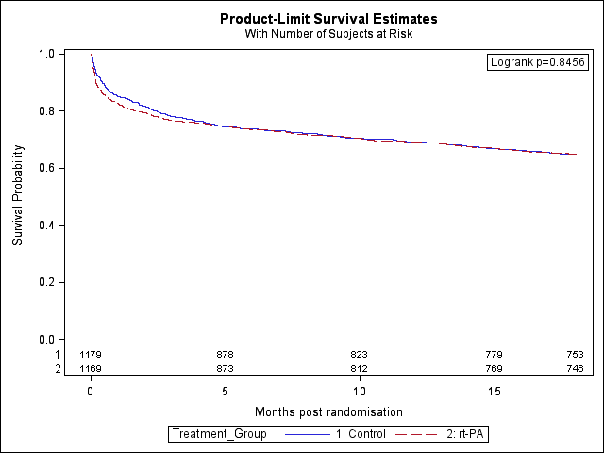
Survival to 18 months

Slide 17
EUROQol 5 domains
Domain | OR* (95% CI) | p
Mobility | 1·30 (1·05 - 1·61) | 0·017
Self-care | 1·43 (1·16 - 1·78) | 0·001
Usual activities | 1·32 (1·07 - 1·62) | 0·008
Pain or discomfort | 1·26 (1·02 - 1·56) | 0·029
Anxiety or depression | 1·05 (0·85 - 1·29) | 0·668
*Adjusted common OR from ordinal analysis of 3 levels within each domain

Slide 18
Living circumstances at 18 months
 | rt-PA |  | Control
 | N | % | N | %
Own home | 574 | 81·0 | 553 | 78·2
Relative's home | 29 | 4·1 | 40 | 5·7
Institution | 45 | 6·3 | 42 | 5·9
Nursing home | 60 | 8·5 | 69 | 9·8
Still in hospital | 1 | 0·1 | 3 | 0·4

